Slide 1

A Perfect family…
Source: https://www.homecareassistancedenver.com/wp-content/uploads/2019/05/Importance-of-Family-in-Seniors-life-2.jpg

Slide 2

INVESTMENTS
Source: https://www.kindpng.com/picc/m/113-1138696_thinking-clip-art-pictures-free-clipart-images-transparent.png
Source: https://banner2.cleanpng.com/20180903/tvq/kisspng-vehicle-insurance-portable-network-graphics-health-ycelsigorta-5b8d0d00b87fd2.7816230415359705607557.jpg

Slide 3
WHY INVESTMENTS ?
Investing is an effective way to use your money to work and potentially build wealth.
Objectives of Investment :
Safety
Income
Capital gains
Factors to be considered while investing:
Reason of investment.
Researching the market.
Risk levels.
Investment Tenure.
Taxations.
Liquidity.
Volatility.
The Company.

Slide 4

TYPES OF INVESTMENTS
Source: https://www.alamy.com/seven-different-types-of-investment-image350667777.html?imageid=944508F7-3B3A-465F-B1F3-B875678FBC3D&p=837470&pn=1&searchId=952ca9778f4be1ea589cfae21b2be834&searchtype=0

Slide 5

Term deposits
Source: https://www.google.co.in/url?sa=i&url=https%3A%2F%2Fpaytm.com%2Fblog%2Ffixed-deposit%2Fdifference-between-fixed-deposits-and-recurring-deposits%2F&psig=AOvVaw0a3_9Z98-kCPDKxzYms1cT&ust=1666955852214000&source=images&cd=vfe&ved=0CA0QjRxqFwoTCLCBoM2kgPsCFQAAAAAdAAAAABAE

Slide 6
Term deposits
Stable not market linked
Risk free investment
Safe return on investments
Minimal amount can be invested
Sum of money is kept for a fixed tenure
Depositor is not allowed to withdraw this sum till the end of the maturity period
Types :
Recurring deposit
Fixed deposit

Slide 7
Recurring V/S fixed deposit
Recurring Deposit
Fixed Deposit
Fixed amount is invested at fixed intervals of time
Normally, once in a month on a fixed date
No service charges
Return on investment (interest) is reinvested
Rate of interest varies
Tenure: 6 months to 10 years
Maturity date cannot be changed
Premature withdrawal possible, but penalty
One time investment
Anytime
No service charges
Return on investment (interest) can be reinvested or deposited to the savings account
Rate of interest depends on tenure
Tenure: 7 days to 10 years
Maturity date cannot be changed
Premature withdrawal is possible, but penalty

Slide 8

Government schemes
Source: https://cdn-ccofj.nitrocdn.com/egjTjcapaIUryXYtMcEvzZpvESYVtgkq/assets/static/optimized/rev-749623b/images/best-government-investment-schemes-in-india.jpg

Slide 9

Atal Pension Yojana (APY)
Social security scheme offered by the Indian Government for people who work in the unorganized sectors.
Best option for economically weaker sections
Give ways to select a pension plan for a better future.
Citizens within the age group 18-40.
Guaranteed pension ranging from Rs. 1000 to Rs. 5000 based on the tenure and investment amount.
Source: https://www.policeresults.com/status-atal-pension-yojana/

Slide 10

Pradhan Mantri Jan Dhan Yojana (PMJDY)
Aims at providing financial services and products for individuals who don’t have a bank account.
Minimum age to open an account is 18 years and 10 years for minors.
Zero balance account
Savings account offers an overdraft facility based on bank transactions and operations.
The premium paid towards the policy is eligible for tax benefits as under section 80C of the Income Tax Act.
Source: https://currentaffairs.adda247.com/pradhan-mantri-jan-dhan-yojana/

Slide 11

Sukanya Samriddhi Yojana (SSY)
Best investment plans for parents of a girl child
Launched in 2015
Aims at uplifting the life of a girl child that will help gain more advantages.
Minimum amount to invest for this scheme is Rs. 1000, and the maximum amount is Rs. 1.5 lakhs per annum.
Payment tenure is 15 years
Parents can open an account in a girl’s name until she attains 10 years.
SSY scheme are eligible for deductions under Section 80C, subject to a maximum cap of Rs 1.5 lakh.
Source: https://wealthtechspeaks.in/sukanya-samriddhi-yojana-scheme.html

Slide 12
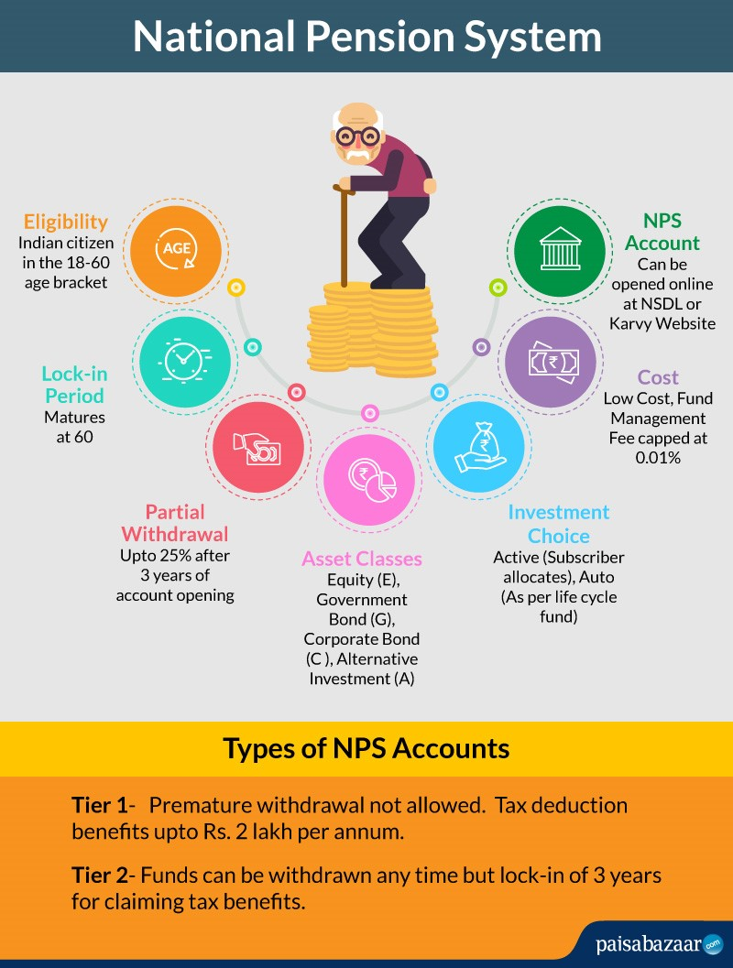
National Pension Scheme (NPS)
A national pension scheme is open to all government employees in India.
Top investment plans available for living independently after retirement.
Investors can even allocate the funds in equities and government securities based on their choices.
Investments made up to Rs. 50,000 are eligible for tax deductions under the income tax act.
NPS sunscribers can claim tax benefit under Sec 80 CCD (1) with in the overall ceiling of Rs. 1.5 lac under Sec 80 CCE.
An additional deduction for investment up to Rs. 50,000 in NPS (Tier I account) is available exclusively to NPS subscribers under subsection 80CCD (1B).
Source: https://www.paisabazaar.com/saving-schemes/national-pension-system/

Slide 13

Sovereign Gold Bonds (SGBs)
Best option available for investors when they don’t want to own and save gold.
Bond comes in Demat form.
TDS is not applicable.
Best government investment schemes available due to its transparency.
Safe scheme that will help provide financial stability.
Source: https://pmmodiyojana.in/sovereign-gold-bond-scheme/

Slide 14
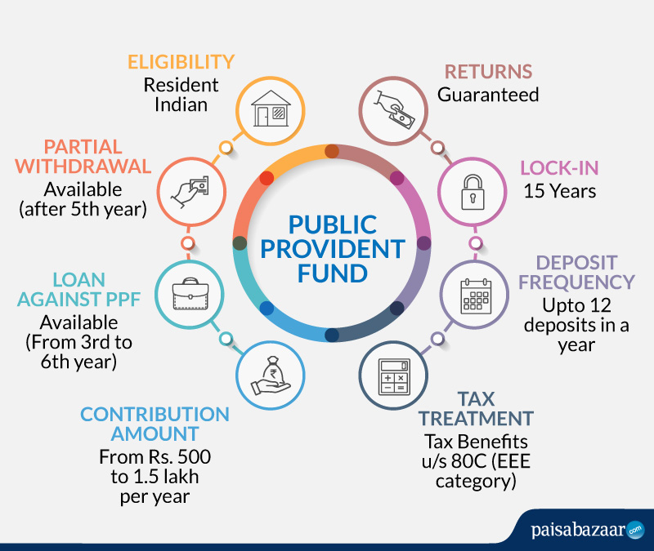
Public Provident Fund (PPF)
A risk-free option that gives ways to get high returns.
Government will determine the interest rates.
Tenure is 15 years, extended up to 5 years
Tax saver (EEE category – Exempt-Exempt-Exempt): all investments are deductible under Section 80C of the Income Tax Act.
Source: https://www.paisabazaar.com/wp-content/uploads/2021/09/PPF.jpg

Slide 15

Prime Minister Vaya Vandana Yojana (PMVVY)
Retirement cum pension plan for senior citizens above 60 years.
Regular fixed sum with an interest rate of 8% to 8.3% for 10 years.
Exempted from ST or GST
Loan up to 75% of purchased price after 3 policy years
Premature exit for treatment of any critical / terminal illness of self or spouse.
Source: https://www.insightsonindia.com/wp-content/uploads/2019/12/Pradhan_Mantri_Vaya.jpg

Slide 16

National Savings Scheme (NSC)
Best savings plan available for individuals to meet essential financial planning needs.
Minimum investment is Rs.100
Maximum no limit
Fixed interest rates based on inflation and other factors
Only Indian residents are eligible to apply for the scheme
Source: https://www.mymoneysage.in/blog/all-about-national-savings-certificate-nsc-withdrawal-transfer-and-tax-benefits/

Slide 17

Government Securities
Bonds and treasury bills (T-bills) are issues to investors
Can be selected based on investor’s choices
Maturity period may range from 91 days to 40 years depending on the securities
High returns that will help generate high income effectively
Can even use them as collateral when they want to borrow funds
Helps a lot to maintain a better cash flow to overcome financial obstacles.
Sourcehttps://wikifinancepedia.com/investing/investment/government-securities-market-india

Slide 18
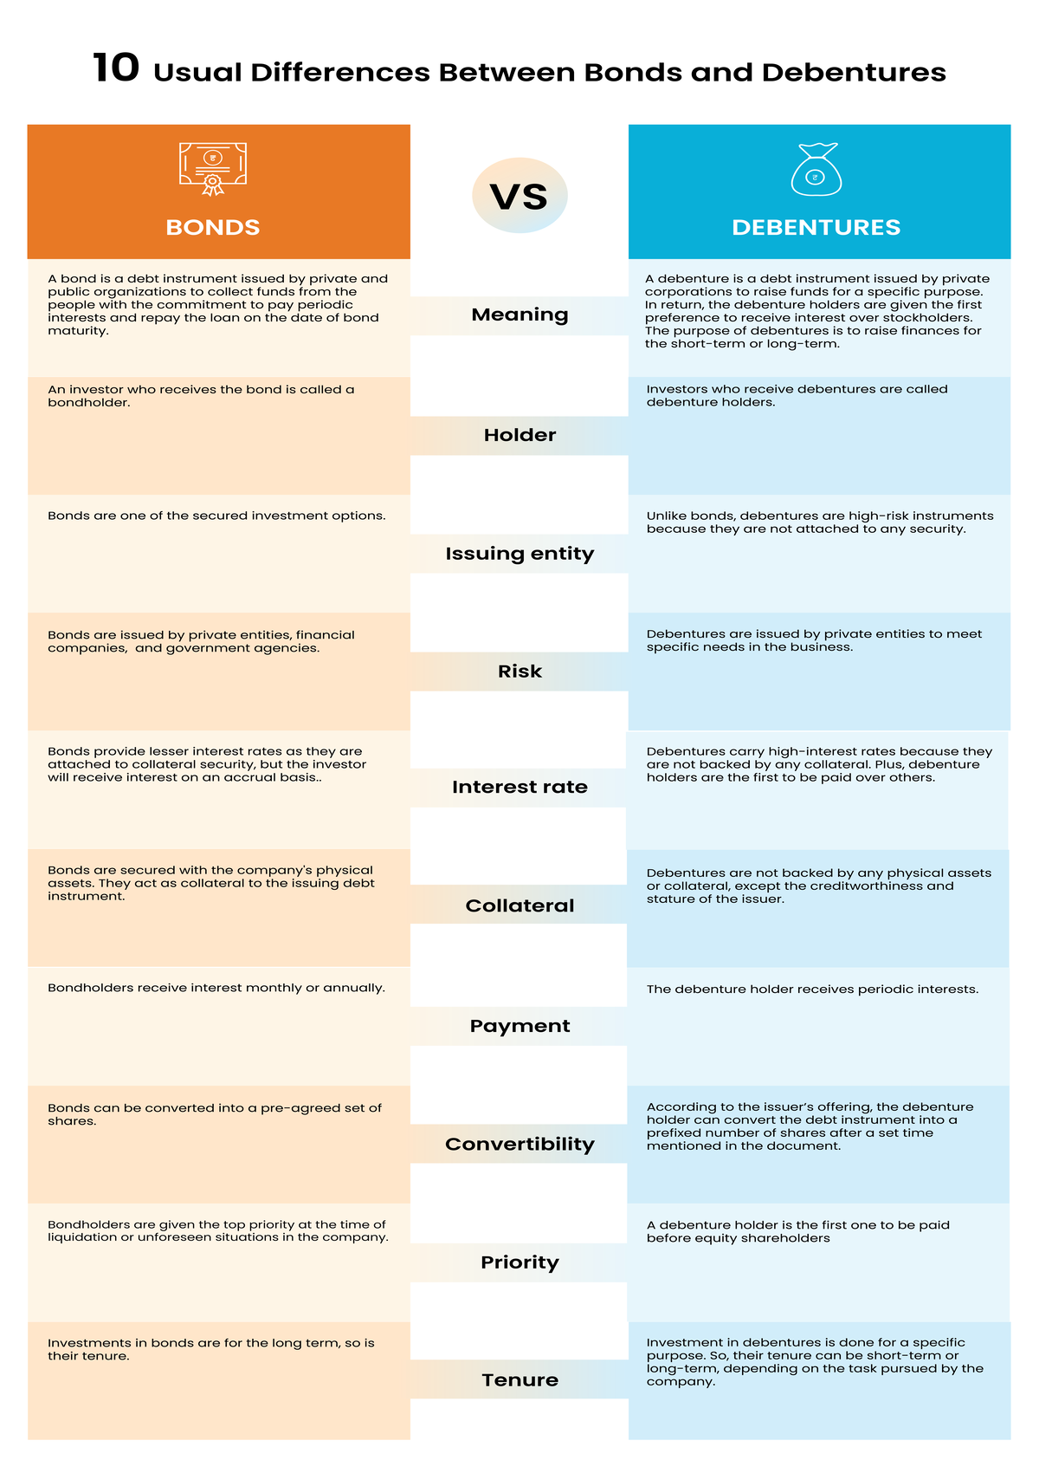
Bonds and debentures
Source: https://www.wallstreetmojo.com/bonds-vs-debentures/
Source: https://blog.bondsindia.com/assest/images/bonds/10-differences-between-bonds/10-differences-between-bonds-and-debentures-in-india-infographic.png

Slide 19
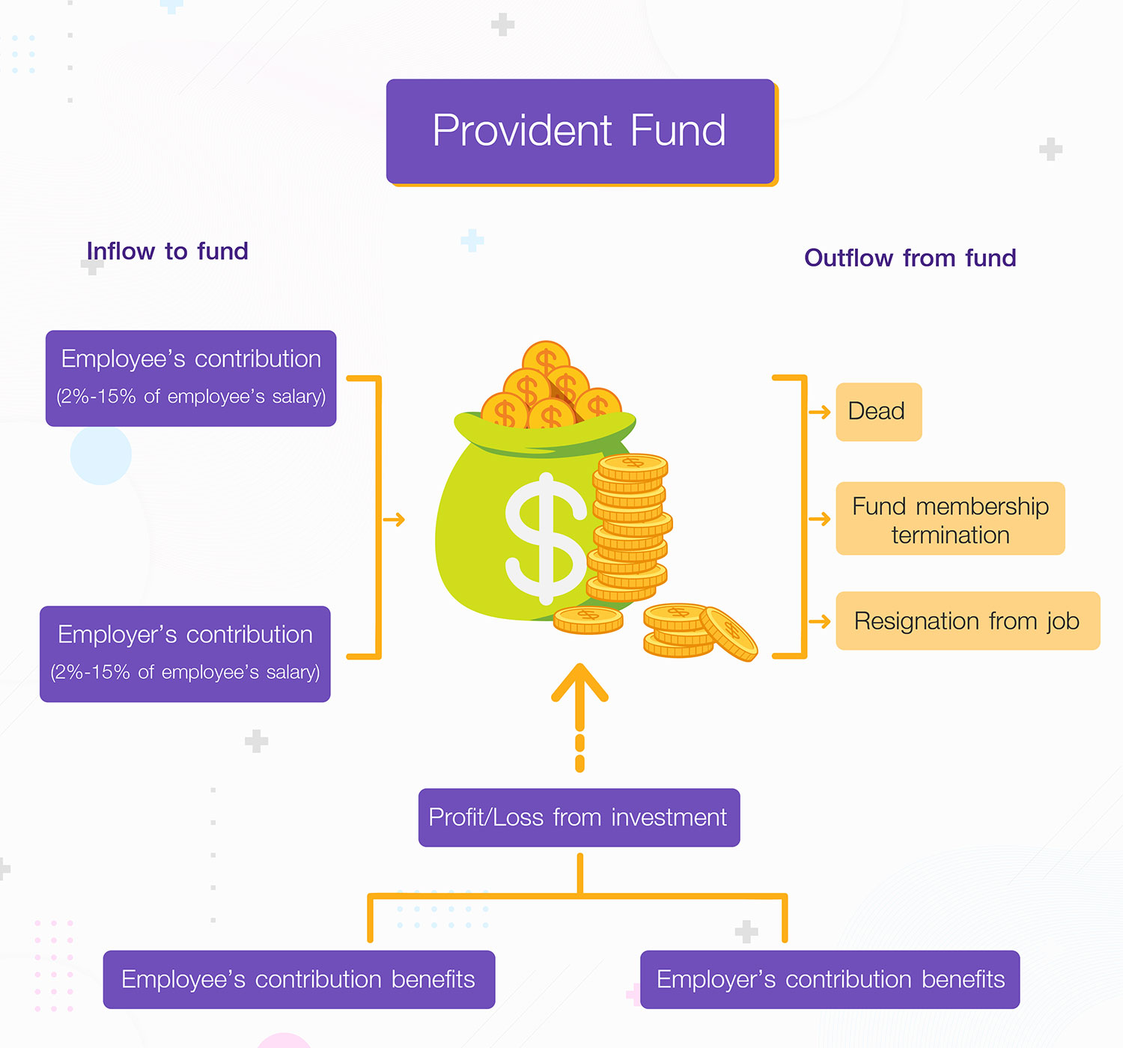
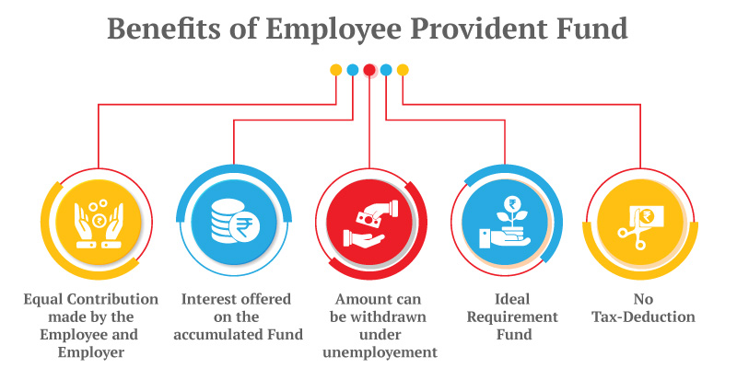
Provident fund
Source: https://www.canarahsbclife.com/blog/all-about-employees-provident-fund-epf.html
Source: https://www.scbam.com/medias/upload/pagepvd/aw-pvd-02-en.jpg

Slide 20

Mutual fund
A mutual fund is a professionally managed financial instrument that pools money from many investors to purchase securities such as stocks, bonds, money market instruments, etc. It offers more diversification and opportunity for investors to make smart investments without being actively engaged in the day to day investment activities.
Advantages:
Built-in diversification
Professional management
Fulfils various investment objectives
Liquidity
Regulation under SEBI (Securities and Exchange Board of India
Source: https://cdn.corporatefinanceinstitute.com/assets/mutual-funds.png

Slide 21
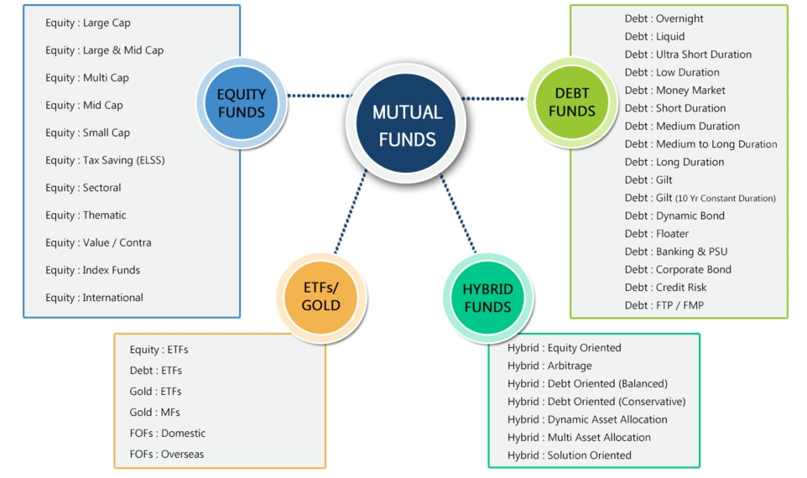
Source: https://www.rupeevest.com/Mutual-Funds/What-is-Mutual-Fund

Slide 22

Gold
Source: https://www.holisticinvestment.in/wp-content/uploads/2019/02/How-to-Invest-in-Gold-in-India.png

Slide 23


stocks
Source: http://myvoice.opindia.com/wp-content/uploads/sites/3/2018/07/BSE-building-trademark.jpg
Source: https://www.vskills.in/certification/blog/stock-market-trends-and-investors/

